Slide 1
UNIT V
Professional Communication skills at Workplace
Intra-interpersonal Communication skills at workplace
Significance of non-verbal communication
Group Discussion- Strategies for effective GD
Presentation skills- Strategies for effective Presentation skills
Interview Skills

Slide 2
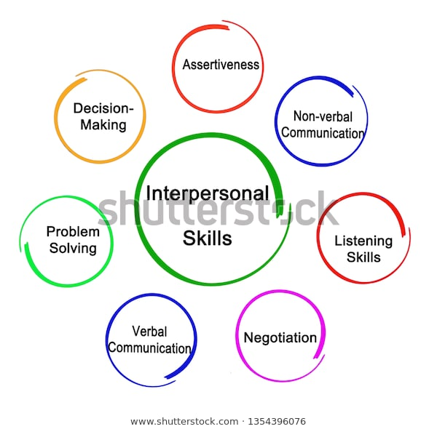
Interpersonal Communication skills at Workplace

Slide 3
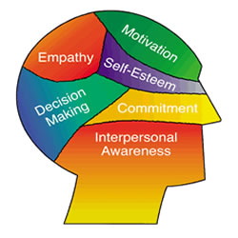
Intrapersonal Communication skills at Workplace

Slide 4
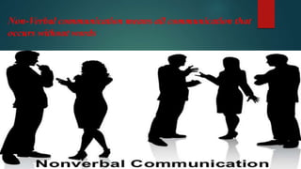
Significance of non-verbal Communication

Slide 5
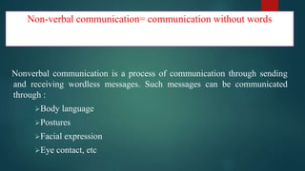

Slide 6
Significance of Nonverbal Communication:
1. Upgrading our Communication System/style.
2. First Impression Leaves Big Impression.
3. It's the Universal Language.
4. Meaningful communication can be possible.
5. Effective communication can be possible.
6. Avoid misunderstanding during communication.
7. Attract the viewer’s towards the communicator.
8. Create better image of the person or an individual.
9. Body language can instantly help to evaluate the interest of people.
10. It is a personal way of expressing emotions when words don’t help.
11. It can make communication more interesting and non-monotonous.

Slide 7
Group Discussion

Slide 8
Strategies for effective GD

Slide 9

Presentation Strategies
What is Presentation?
A presentation is a technique or a method of communicating ideas and information to a group of people. It carries the speaker’s personality better and allows interaction between all the participation.

Slide 10
Objectives of Presentation:
To provide information.
To teaching a lesson.
To sell a product, service or strategy.
To obtain a decisions.
To solve a problem.

Slide 11
Components of effective Presentation
Defining purpose
Analysis of audience and location
Organizing contents-
1. Introduction 2. Body 3. Conclusion (iv) Preparing an outline of the presentation (v) Visual aids (vi) Nuances of delivery-
Extemporaneous, Manuscript (vii) Body language and effective presentation

Slide 12
Answer the following questions by choosing correct options giving below.
1. Body language can make or break a speech.
a) True b) False
2. Which of these is the study and classification of speech sounds?
a) Gestures b) Speech style
c) Phonetics d) Spoof
3. Which of these is not an element of the speaking technique?
a) Voice quality b) Word stress
c) Appearance d) correct tones
4. Which of these means giving emphasis to a syllable?
a) Voice quality b) Word stress
c) Tone d) Message
5.Which of these factors is not involved in the determination of correct tone?
a) Pitch b) Dressing style
c) Quality d) Strength

Slide 13
6. Which of these is not a type of tone?
a) Urgent tone b) Serious tone
c) Restrained tone d) Jumping tone
7. Which of these tones represent thoughtfulness?
a) Serious tone b) Urgent tone
c) Happy tone d) Outraged tone
8. Which of these tones is an unemotional tone?
a) Happy tone b) Outraged tone
c) Restrained tone d) Humorous tone
9. tone is used when speaker wants to bring about a good impression of her life.
a) Outraged b) Reflective
c) Restrained d) Urgent
10. Which of these tones is used to express contentment?
a) Serious tone b) Happy tone
c) Outraged tone d) Urgent tone

Slide 14
Answer
1.A. True
2.C. Phonetics
3.C. Appearance
4.B. Word stress
5.B. Dressing style
6.D. Jumping tone
7.A. Serious tone
8.C. Restrained tone
9.B. Reflective
10.B. Happy tone

Slide 15
Interview skills
The word interview comes from Latin and middle French words meaning to “see between” or “see each other”. Generally, an interview means a private meeting between people when questions are asked and answered
Interview = A meeting with an objective.
Employer’s objective is to find the best person for the job.
Employer: reviews candidate’s experience and abilities
Can you do the job? (skills, abilities, qualifications)
Will you do the job? (interest, attitude & motivation)
How will you fit into the organisation? (personality)

Slide 16
Objectives of Interview
In the selection process, interview serves the following:
Verifies the information obtained through application form and tests.
Helps obtain additional information from the applicant otherwise not available.
Gives the candidate necessary facts and information about the job and the organisation.
Helps establish mutual understanding between the company and the candidate and build the company’s image.

Slide 17
Types of Interviews
Basic/traditional interview
Telephone interview
Group interview
Interview during a meal or social occasion
Serial interview

Slide 18
5 Stages Interview Process
Icebreaker
Greetings
First Impressions
Small talk
Personal Qualifications and Interest in Position
Abilities, Skills, and Work Experience
Accomplishments and Activities
Goals
3. Organization and Position
Employer may test your knowledge of the company.
“Why do you want to work for this company?”
“What do you know about this department?”
Other general questions regarding the company or the job.
“What is your geographic preference?”
“Are you willing to relocate?”

Slide 19
Candidate Questions
Your chance to ask questions about job
“What type of on the job training do you provide?”
“What makes your company different from its competitors?”
Close and Follow-Up
Find out who makes next move
Thank the interview for their time
Evaluate your performance
Send a thank you note within 24 hours

Slide 20
Tips for Successful Interviewing
Interviewing is a two-way process.
Never give “yes” or “no” answers.
Listen carefully and react.
Use specific examples to make your case.
Be positive!
Think like an employer.
Don’t criticize past employers or co-workers.
Be aware of illegal questions.
Maintain professionalism, even if the employer does not.
Be prepared for the unexpected questions.
Be aware of body language.

